Slide 1
Analysis of Indian Suicide Data for Prediction of Number of Suicides Given Features of a Population
Selva Priyanka S, Sudeep Galgali, Selva Priya S, Shashank BR, Dept. of CSE, M. S. Ramaiah Institute of Technology

Slide 2
introduction
Every year about 800,000 commit suicides all over the world [1], of these 135,000 (17%) are residents of India, [2] a nation with 17.5% of world population.
Estimates for number of suicides in India vary. For example, one study projected 187,000 suicides in India in 2010, [5] while official data by the Government of India claims 134,600 suicides in 2010. [2]
In this project an attempt has been made to identify the causes of suicides. This is done by calculating how correlated features of a state are with the number of suicides. The features include marital, professional and educational status of the state’s population. After this the significant features are used to predict number of suicides.

Slide 3
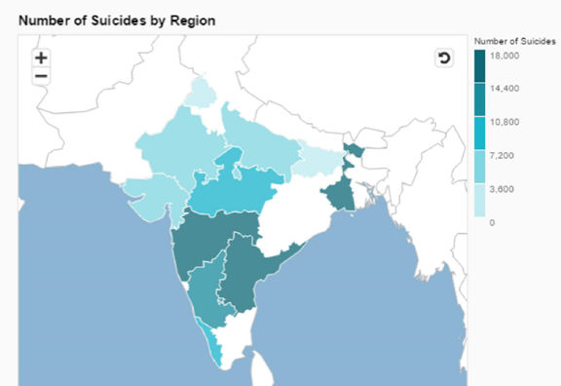
Suicides in india

Slide 4
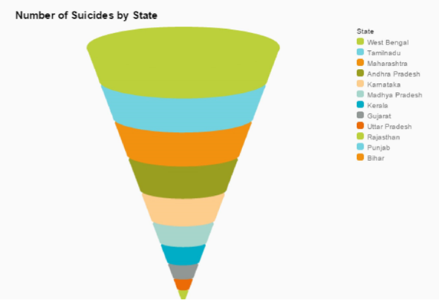
Suicides in india

Slide 5
Dataset creation
The aim of dataset creation is to prepare a single dataset for analysis which is sourced by multiple datasets. The list of datasets used is
12 Marital status of population datasets for each state in 2011[7]
12 Educational level of population datasets for each state in 2011[7]
12 Primary census abstract datasets for each state in 2011[7]

Slide 6
States considered
Andhra Pradesh
Bihar
Gujarat
Karnataka
Kerala
Madhya Pradesh
Maharashtra
Punjab
Rajasthan
Tamil Nadu
Uttar Pradesh
West Bengal

Slide 7
features
Total Persons
Total Males
Total Females
Marital Status - Never Married Persons
Marital Status - Never Married Males
Marital Status - Never Married Females
Marital Status - Currently Married Persons
Marital Status - Currently Married Males

Slide 8
features
Illiterate - Persons
Illiterate - Males
Illiterate - Females
Literate - Persons
Literate - Males
Literate - Females
Educational level - Literate without educational level - Persons
Educational level - Literate without educational level - Males
Educational level - Literate without educational level - Females

Slide 9
features
Main Agricultural Laborers Population Female
Main Household Industries Population Person
Main Household Industries Population Male
Main Household Industries Population Female
Non Working Population Person
Non Working Population Male
Non Working Population Female

Slide 10
Pearson correlation
Correlation is a technique to measure how two sets of data are related.
The correlation coefficient always lies between -1 and 1.
We have calculated the Pearson correlations for all the 69 features with the number of suicides and selected only those for modeling which have a value greater than 0.5.

Slide 11
Pearson correlation
Feature | Correlation co-efficient
Marital Status – Widowed Females | 0.5025
Marital Status - Separated Persons | 0.7209
Marital Status - Separated Females | 0.8618
Marital Status – Divorced Females | 0.5558
Educational level - Technical diploma or certificate not equal to degree - Persons | 0.5842
Educational Level- Technical Diploma or Certificate not equal to Degree - Males | 0.6265
Main Working Population Female | 0.6429
Main Agricultural Laborers Population Female | 0.5914
Main Household Industries Population Female | 0.5452

Slide 12
inferences
Separated and widowed Females have a very high correlation with the number of suicides, which prompts us to believe that this is the most important factor in predicting the suicide rates.
The next in line is the farmer, the main agricultural laborers population.
Men with a technical diploma or certificate not equal to degrees.
People who own or work in household industries.
People with a technical diploma or certificate not equal to degrees.
Working female population

Slide 13
Linear regression modeling
A linear model is developed for the significant features to predict number of suicides The Classical Ordinary Least Squares method is used to estimate the number of suicides.

Slide 14
results
R-squared | 0.961
Percentage Fit | 96%
Percentage Accuracy | 94.1363%
RMS Error | 543
Ftest Pvalue | 0.00697

Slide 15
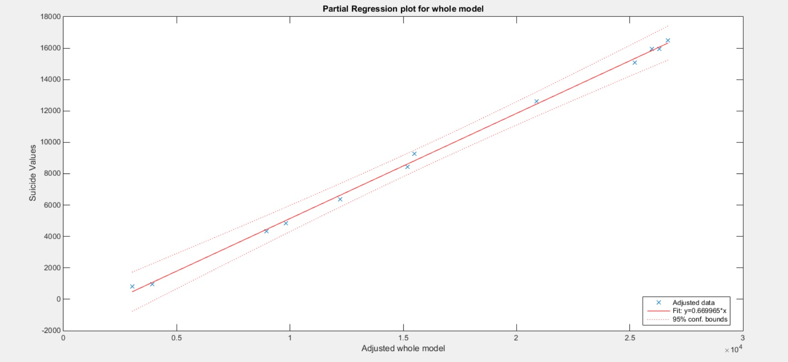
Partial regression plot

Slide 16
conclusion
From this we can conclude that the rate of suicides depends mainly on the identified factors of the total population. If given the total number of separated females, farmers, men with no degrees or just a technical diploma, people working on household industries, total number of people without degrees or with just a technical diploma, people working in household industries, divorced females and people without jobs of a particular state, we can predict with a great accuracy the number of suicides for that state.

Slide 17
Future work
We would like to conduct such a study considering the remaining states and find what group of the population has a significant relationship on the number of suicides. We also want to consider features other than the population.

Slide 18
references
Suicide prevention (SUPRE) World Health Organization (2012)
Suicides in India The Registrar General of India, Government of India (2012)
Vijaykumar L. (2007), Suicide and its prevention: The urgent need in India, Indian J Psychiatry;49:81-84,
Polgreen, Lydia (March 30, 2010). "Suicides, Some for Separatist Cause, Jolt India". The New York Times.
Patel, V.; Ramasundarahettige, C.; Vijayakumar, L.; Thakur, J. S.; Gajalakshmi, V.; Gururaj, G.; Suraweera, W.; Jha, P. (2012). "Suicide mortality in India: A nationally representative survey". The Lancet 379 (9834): 2343. doi:10.1016/S0140-6736(12)60606-0.
Suicide Rates - Data by country. World Health Organization 2012. Retrieved 30 November 2015.
Census India 2011
David A. Freedman, “Statistical Models: Theory and Practice”, Cambridge University Press. P. 26, 2009.Richard Taylor, “Interpretation of the correlation coefficient:A Basic Review” ,JDMS 1:35-39, January/February 1990.
Hayashi, Fumio (2000). Econometrics. Princeton University Press.ISBN-0-691-01018-8

